Slide 1
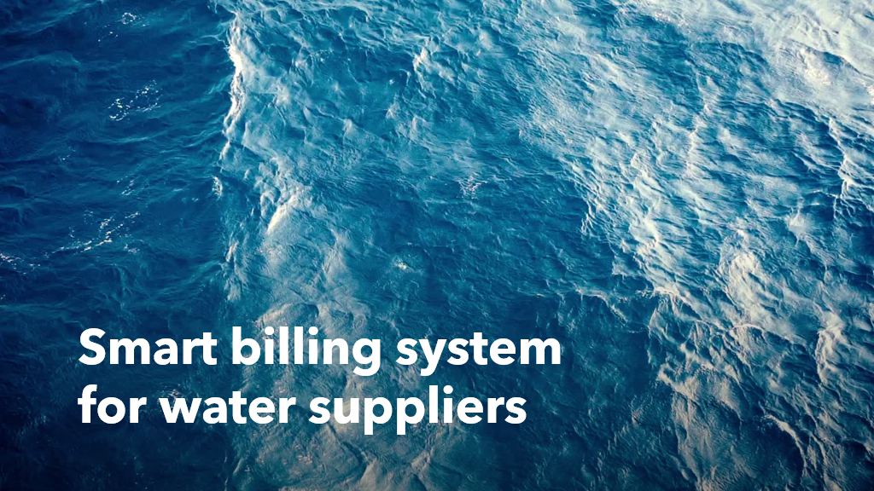
Presented by
18481A04B9
18481A04C0
18481A04C1
18481A04C2
18481A04C3

Slide 2
CONTENTS:
INTRODUCTION
LITERATURE SURVEY
THEORETICAL ANALYSIS
EXPERIMENTAL INVESTIGATIONS
FLOWCHART
RESULT
ADVANTAGES AND DISADVANTAGES
APPLICATIONS
CONCLUSION
FUTURE SCOPE
BIBILOGRAPHY
APPENDIX

Slide 3
INTRODUCTION:
In recent times, development in computing and consumer electronics technologies have triggered Internet of Things (IoT) paradigm. Internet of Things (IoT) is described as enabler that links seamless objects surrounding the environment and performs some sort of message exchange among them.
This is useful to metropolitan cities operate water tanker services for delivery to residents needing drinking water from several fill stations across cities. And to make the payment easy by using RFID card.

Slide 4
EXISTING PROBLEM:
Massive populations in many parts of the world, including in India, continue to grapple with lack of access to clean and safe water.
The analysis finds challengesin five aspects related to water supply in metropolitan cities: quantity; quality; coverage;use; and disposal.

Slide 5
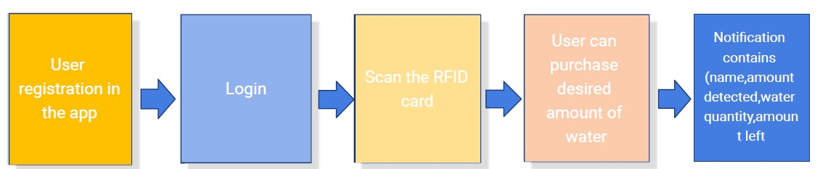
BLOCK DIAGRAM:

Slide 6
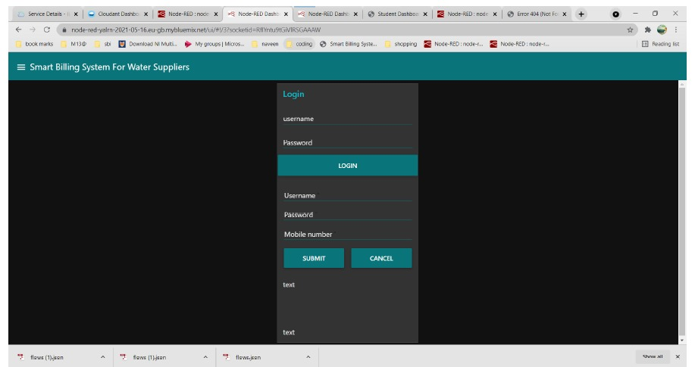
LOGIN FORM:

Slide 7
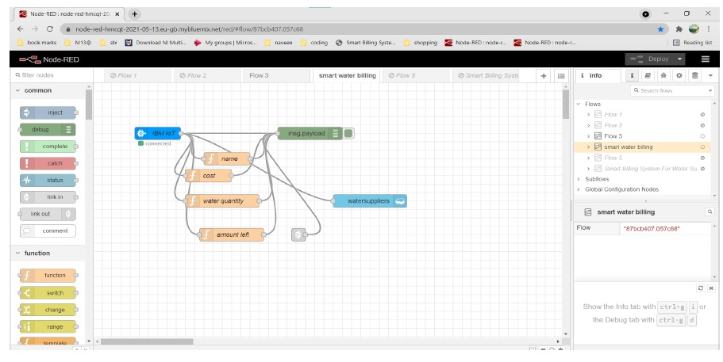
EXPERIMENTAL INVESTIGATIONS:

Slide 8
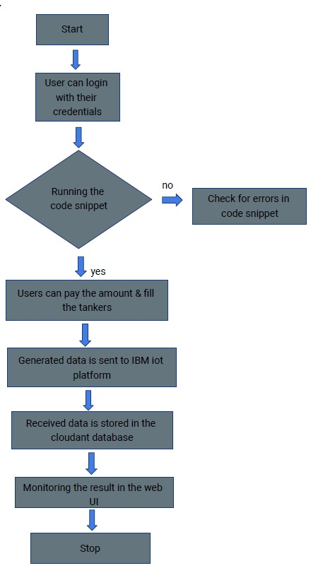
FLOW CHART:

Slide 9
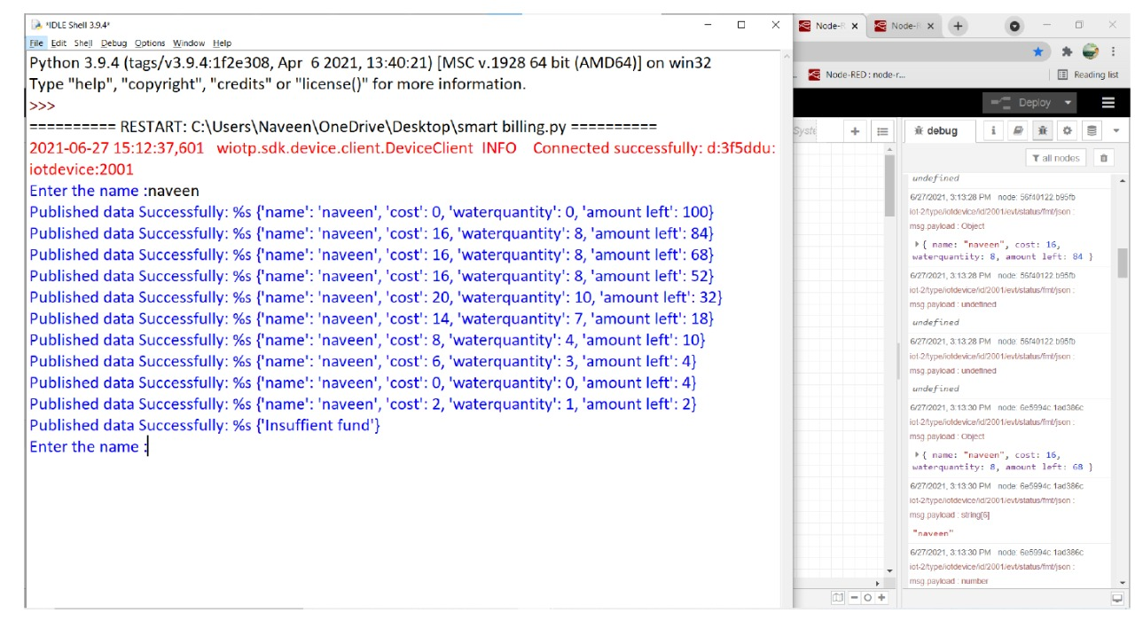
RESULTS:

Slide 10
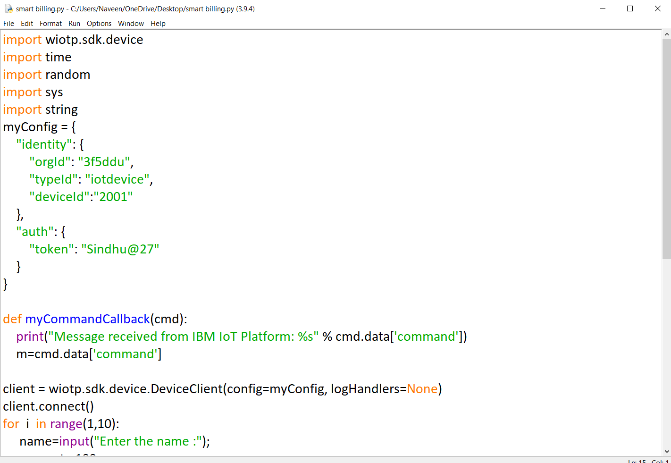
Code:-

Slide 11
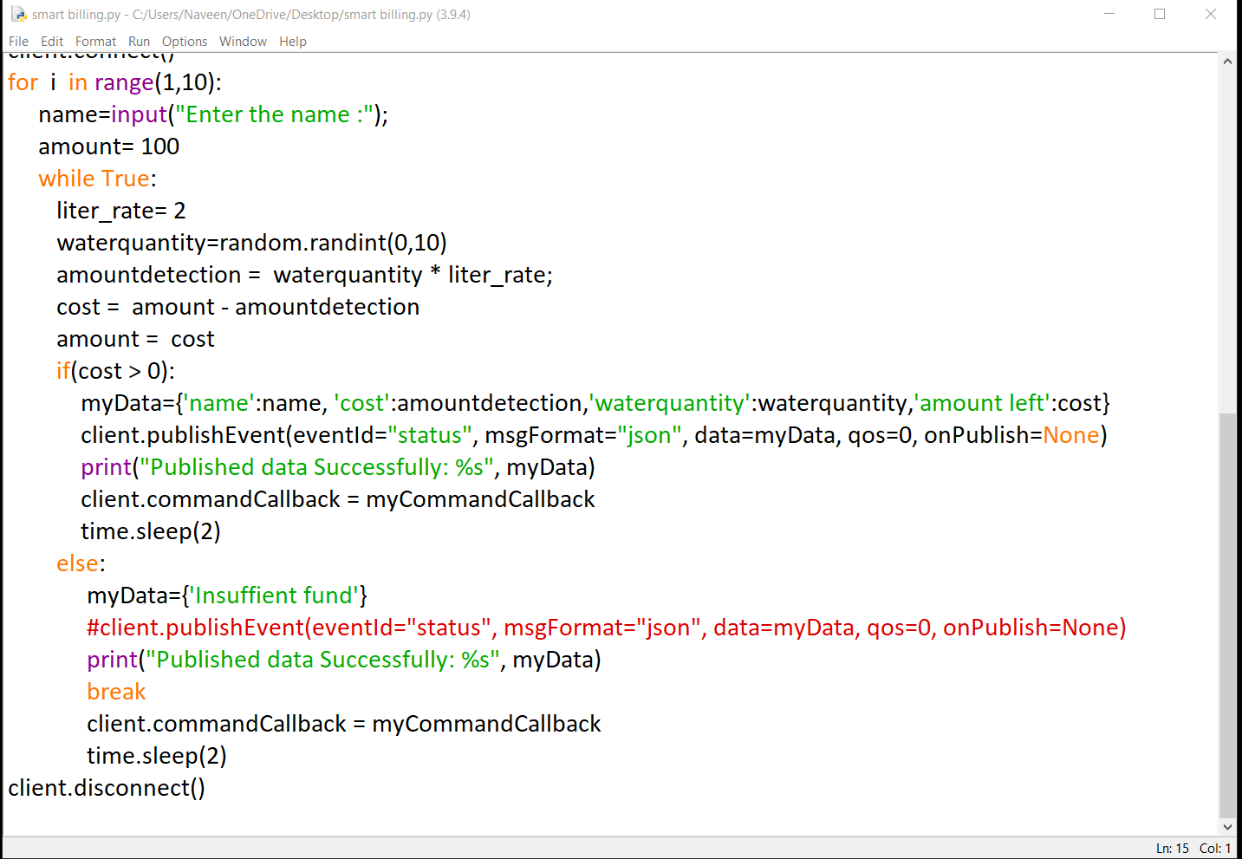

Slide 12
UI OUTPUT:

Slide 13
ADVANTAGES:
Reduces material costing that comes with manual billing and filing.
Retail billing software helps small business to penetrate offline and online much conveniently.
DISADVANTAGES:-
It is not cost-effective for small scale business owners.
Reaching offline customers who do not access the internet makes the process difficult.

Slide 14
APPLICATIONS:
Instant new invoices.
Individual customer tracking.
Generte tax reports

Slide 15
CONCLUSION:
Proposed system will provide accurate and real time water billing system. This overcomes existing systems in terms of cost and manpower required. This is suitable practical solution for water bill management. Water level of main tank water is monitored to avoid wastage of water.
This system is user friendly for water supply management.
FUTURE SCOPE:
This project can be extended beyond by using the controlling the leakage of the water from the tank, household usage of water

Slide 16
BIBILOGRAPHY:
https://papers .ssrn.com/sol3/papers.cfm?abstract_id=3645321
https://electricitybilling.com/water-billing-software/
Code:-

Slide 17


